Slide 2
Why 3D, erik
Concept and 2D-3D compare
Accuracy, Tuan
With fuel cells phantom
Real, Michael
Experiment, Issues

Slide 3
Accuracy

Slide 4
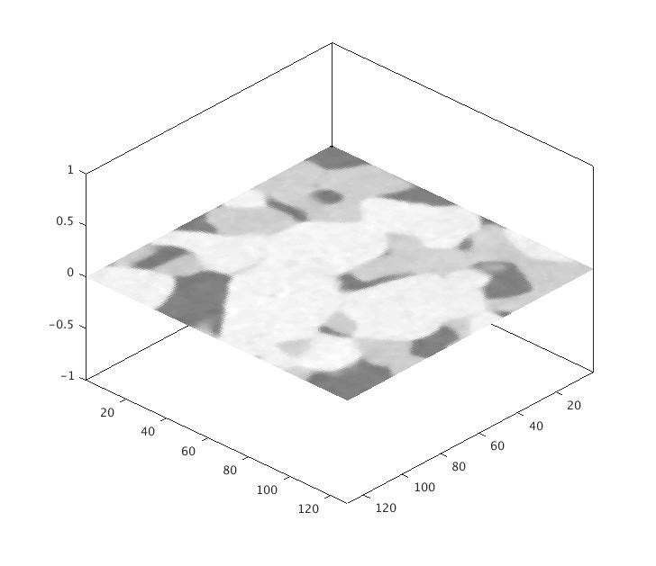
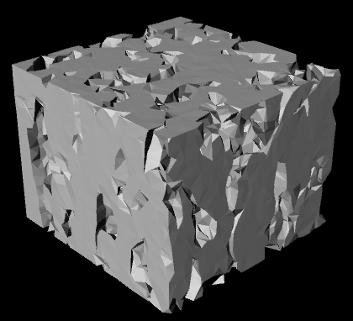
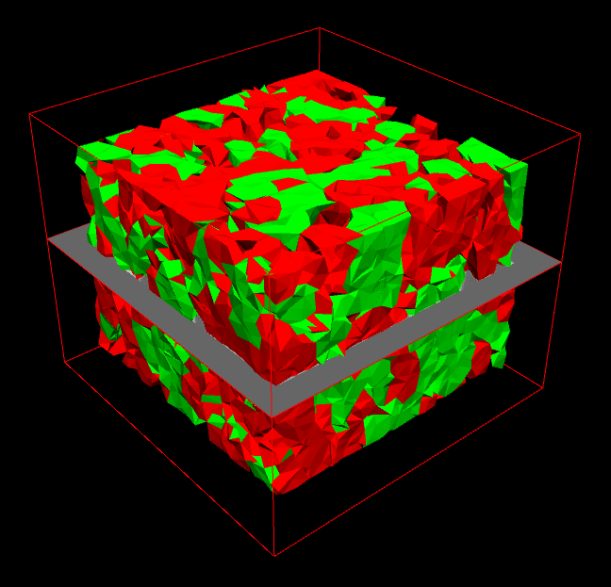
Accuracy
The phantom fuel cells
The phantom fuel cells consists of two types of material

Slide 5
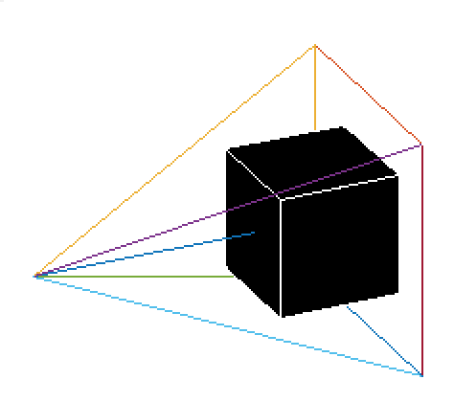
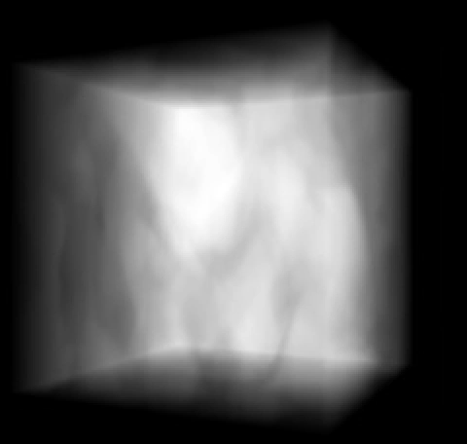
Accuracy
Cone beam setup
The object rotates by its center
Image observed by the detector

Slide 6
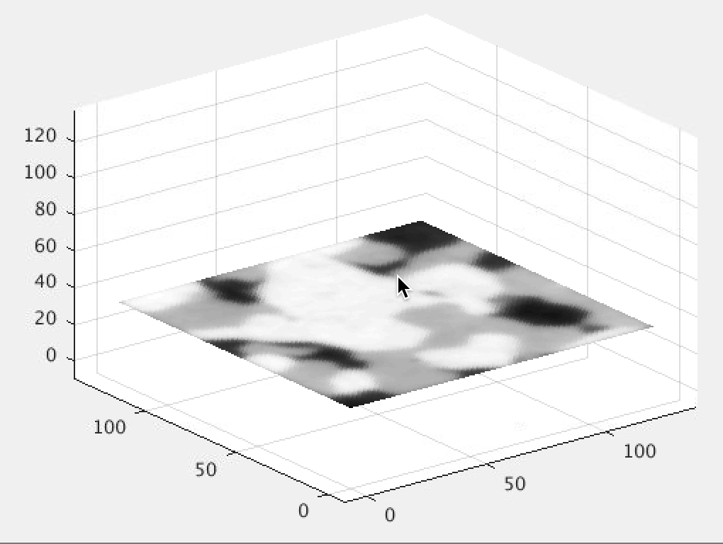
Accuracy
Reconstruction from phantom fuel cells

Slide 7
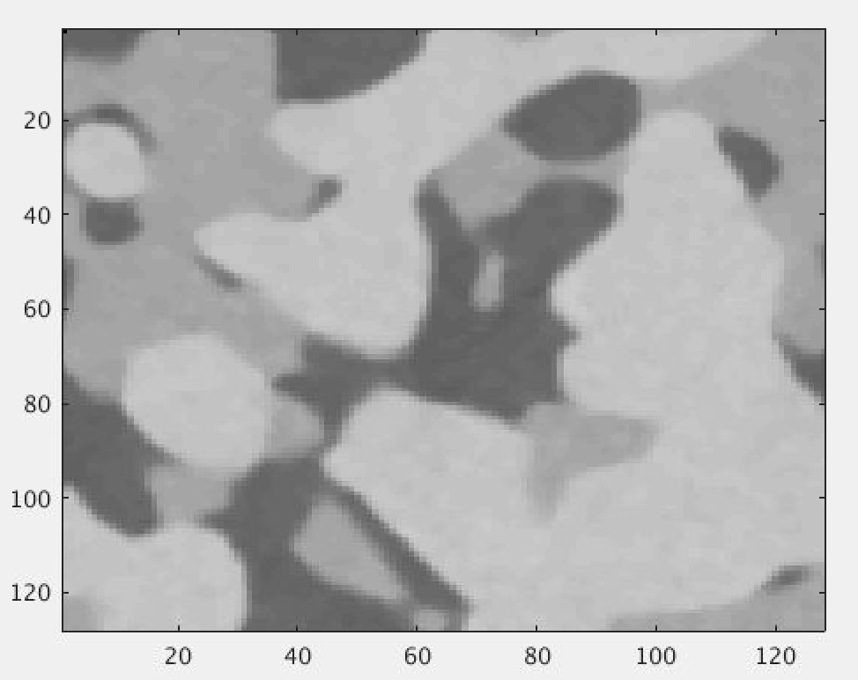
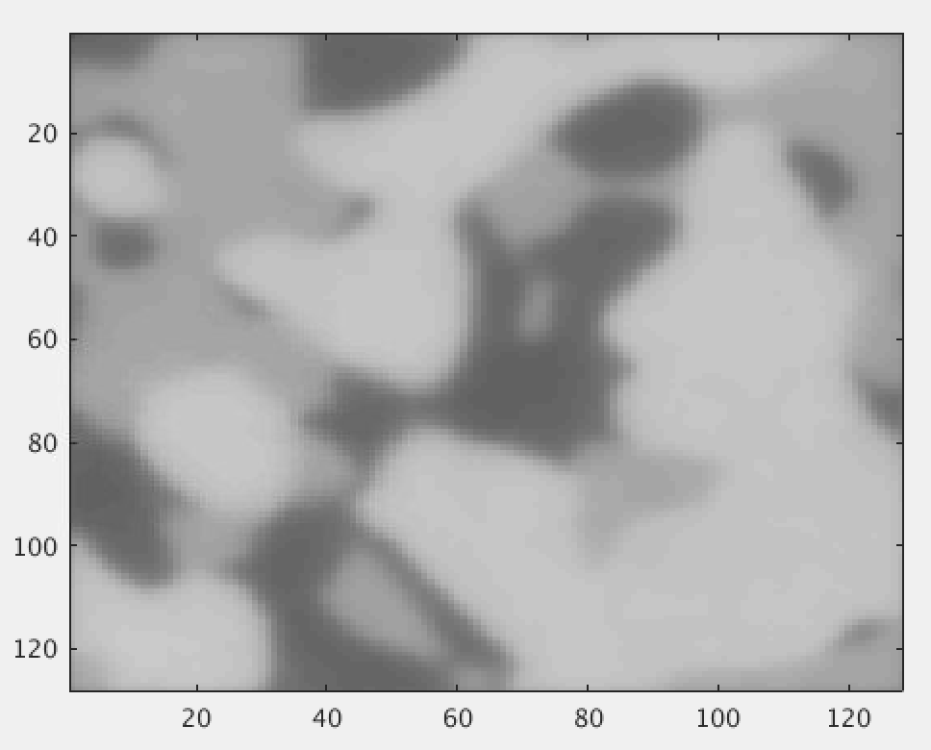
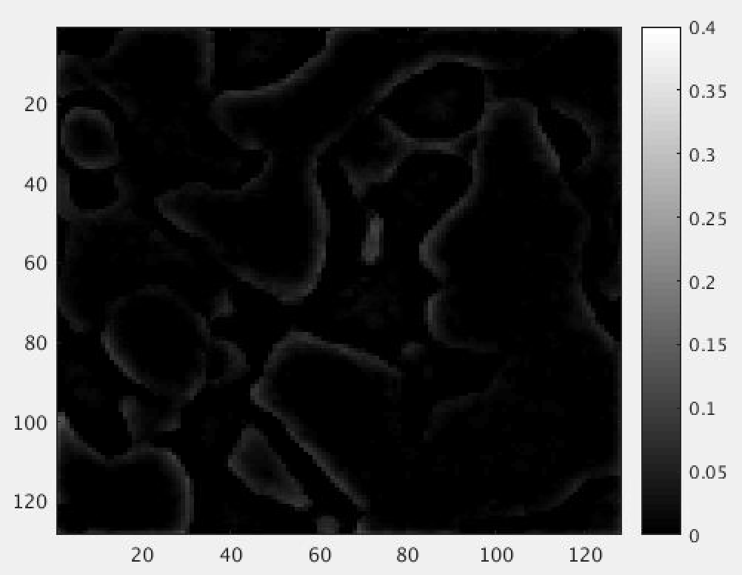
Accuracy
Difference
Phantom
reconstructed
difference

Slide 8
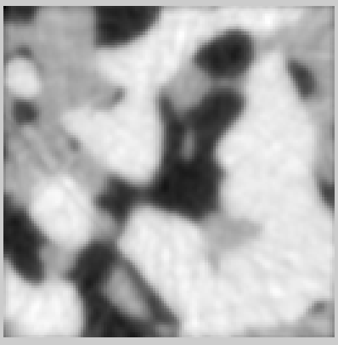
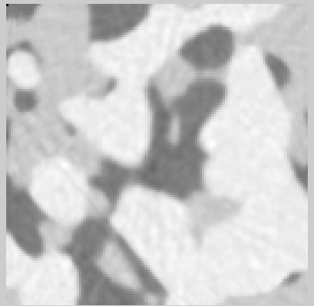
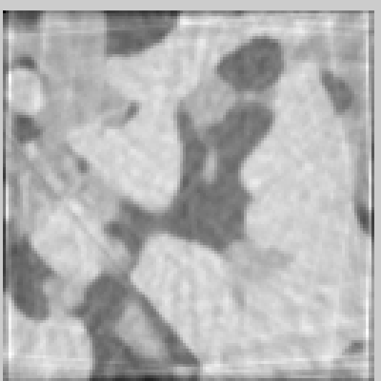
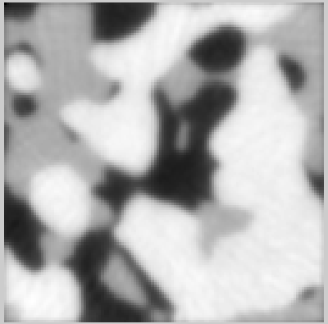
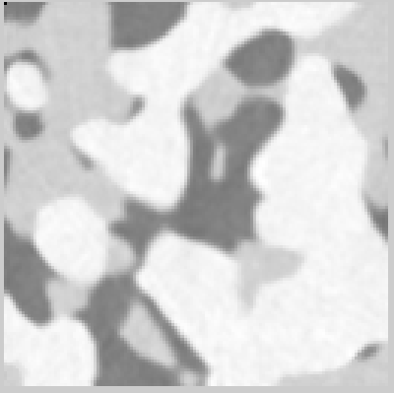
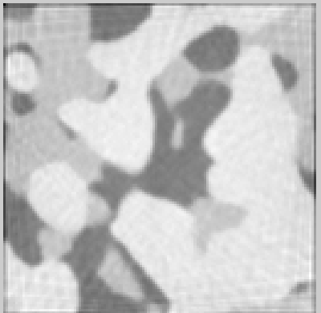
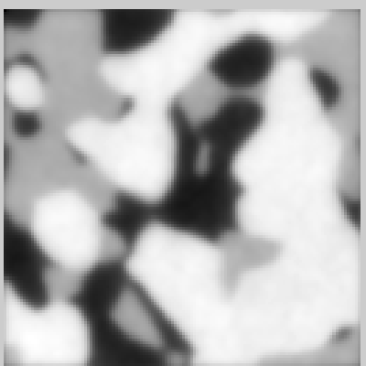
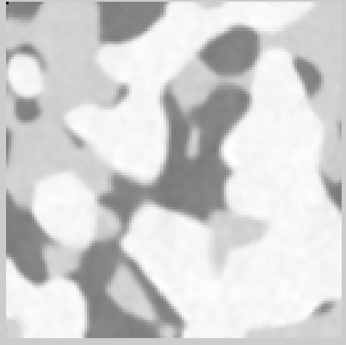
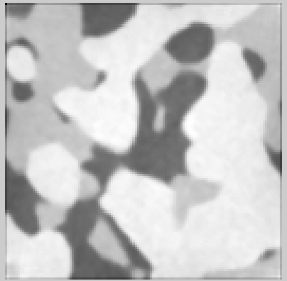
CGLS
SIRT
FDK
50 projections
8e-4
2e-4
3.5e-2
100 projections
7.2e-4
5e-5
3.4e-2
400 projections
7e-4
2e-5
3.2e-2

Slide 9
3D reconstruction in real life, issues

